Slide 1
BDA Assignment 4
Aakash Tanwar (2016215)
Priya Rajpurohit (2015073)

Slide 2
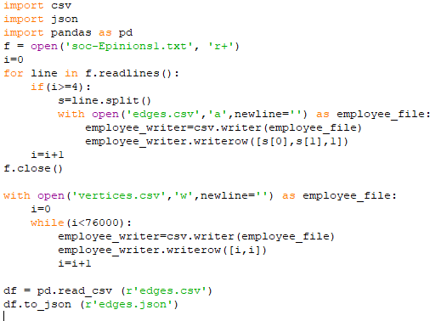
Conversion Code to create Graph (Vertex & Edge CSV)

Slide 3
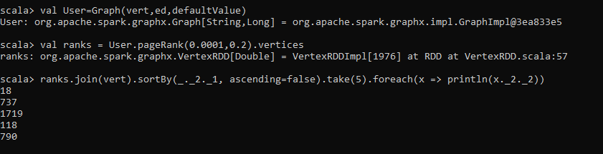
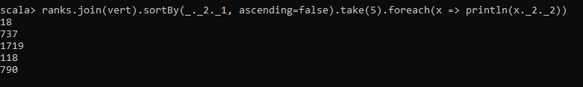
Run Pagerank on the dataset and report the top-5 most trusted users, where a user with a higher page rank is more trusted than a user with a lower page rank score. (Use alpha=0.8)
Top-5 most trusted users

Slide 4
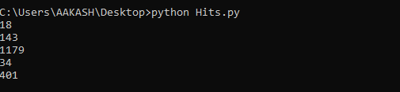
Run HITS algorithm on the dataset and report the top-5 most trusted users, where a user with a higher authority score is more trusted than a user with the lower authority score.

Slide 5
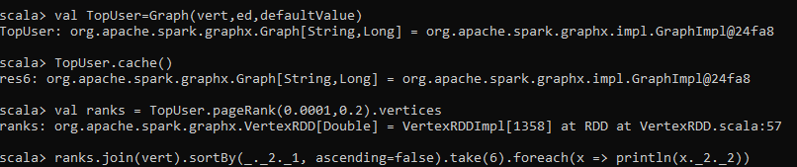
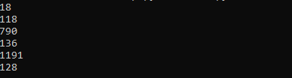
Run Simrank (variant of pagerank where the teleporting is done to a limited set of users )
algorithm to find out the top-5 users who are in the trusted circle of the user with the
highest page rank.

Slide 6
References
https://docs.databricks.com/spark/latest/graph-analysis/graph-analysis-graphx-tutorial.html
https://github.com/jaimeps/hits-algorithm/tree/1e35ba533b2c2f3bd2305b7a4c1ff8520fecb25f
https://github.com/wanesta/Simrank/blob/master/src/main/scala/com/autohome/algo/simrank/Simrank.scala

